Slide 1
EJB

Slide 2
What is an EJB
Enterprise JavaBeans ≠ JavaBeans
Enterprise beans are the Java EE server side components that run inside the ejb container
Encapsulates the business logic of an enterprise application.

Slide 3
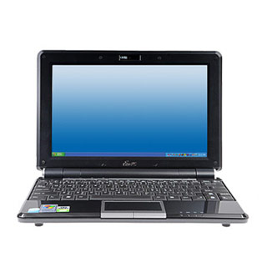
Where is an EJB
Client Tier Server Data Tier
Web Tier Business Tier
JSP /
Servlet
EJB

Slide 4
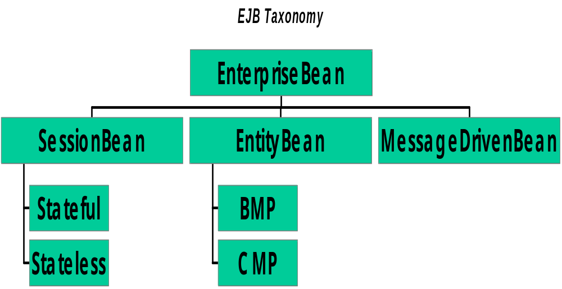
Types of EJB
_{New!}

Slide 5
1. Session Bean
A session bean is the enterprise bean that directly interact with the user and contains the business logic of the enterprise application.
A session bean represents a single client accessing the enterprise application deployed on the server by invoking its method.
An application may contain multiple sessions depending upon the number of users accessing to the application.

Slide 6
Stateless Session Beans
A stateless session bean does not maintain a conversational state with the client.
When a client invokes the methods of a stateless bean, the instance of bean variables may contain a state specific to that client only for the duration of a method invocation.
Once the method is finished, the client-specific state should not be retained i.e. the EJB container destroys a stateless session bean.

Slide 7
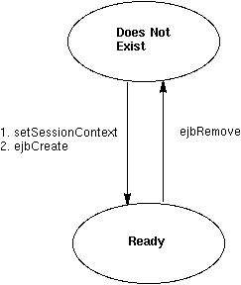
Stateless Life Cycle
Because a stateless session bean is never passivated, its life cycle has just two stages: non-existent and ready for the invocation of business methods.

Slide 8
State full Session Bean
A stateful session bean retains its state across multiple method invocations made by the same client.
If the stateful session bean's state is changed during a method invocation, then that state will be available to the same client on the following invocation.
The state of a client bean is retained for the duration of the client-bean session. Once the client removes the bean or terminates, the session ends and the state disappears.

Slide 9
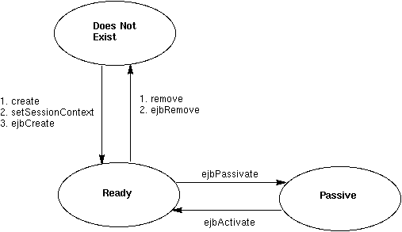
Stateful Life Cycle

Slide 10
Entity Bean
An entity bean represents an entity kept in a persistent storage mechanism, usually a database.
A business application, for example, might use a database to store business entity objects such as accounts, customers, orders, and products.
Inside the J2EE server, this application would represent the business entity objects with entity beans.

Slide 11
Types of Entity Bean
Bean-managed persistence (BMP):
bean developer writes JDBC code to access the database; allows better control for the developer
Container-managed persistence (CMP):
container generates all JDBC code to access the database; developer has less code to write, but also less control

Slide 12
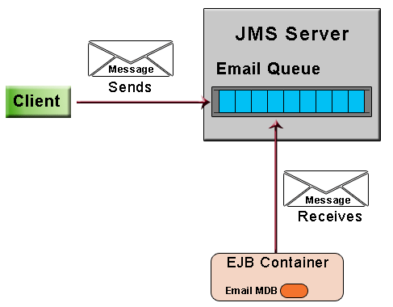
Message Driven Beans
Message driven beans are the light weight components used for communication.
In message driven beans the messaging service is in asynchronous mode.

Slide 13
Example for State Less Session Bean

Slide 14
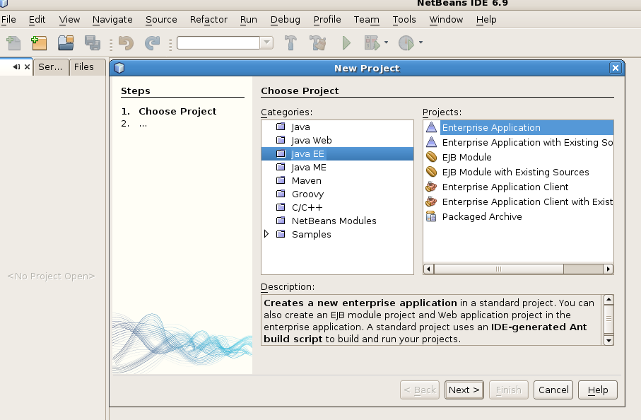
Example

Slide 15
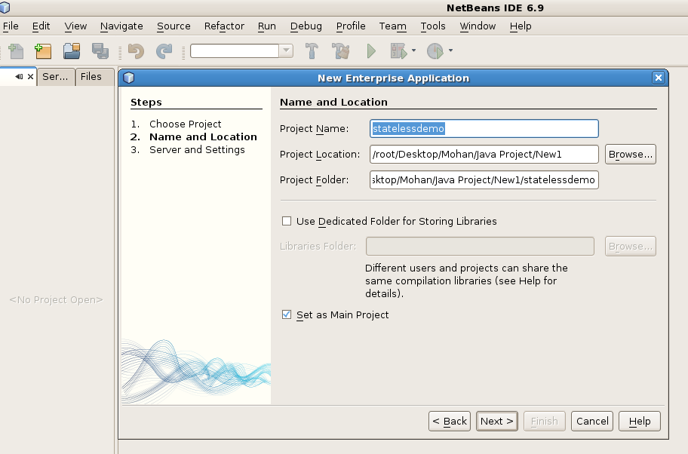

Slide 16
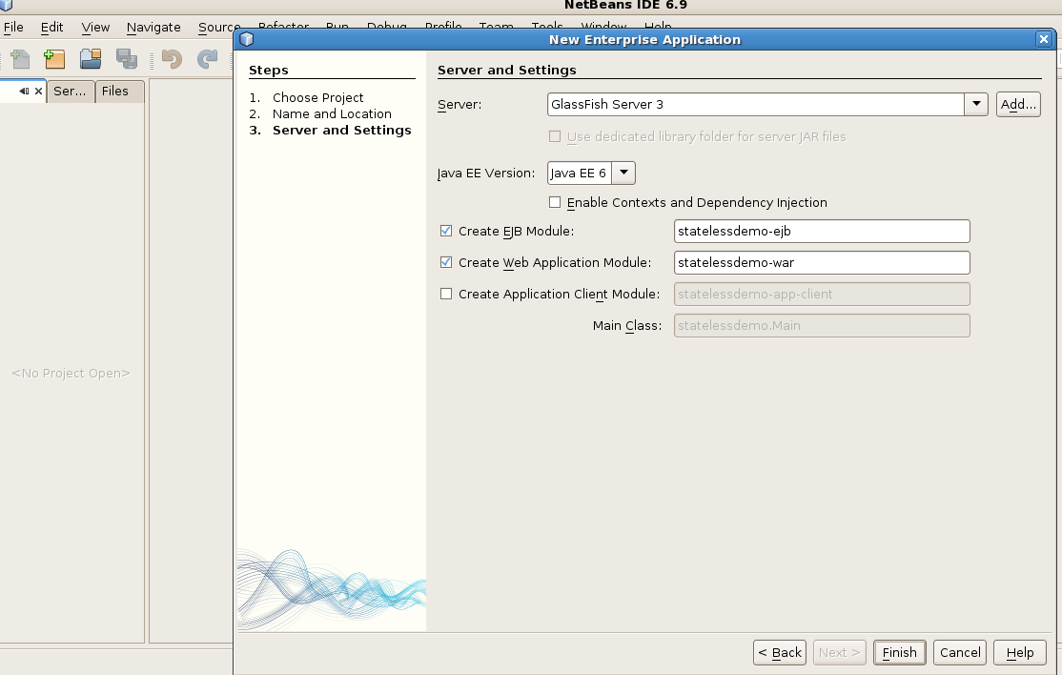

Slide 17
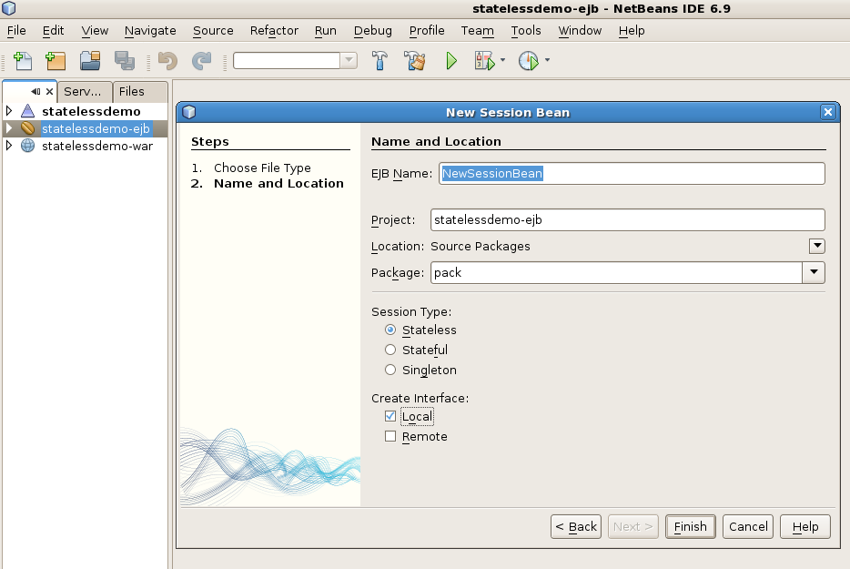

Slide 18
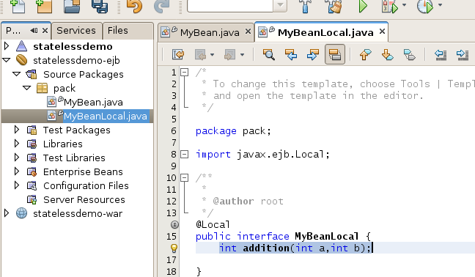
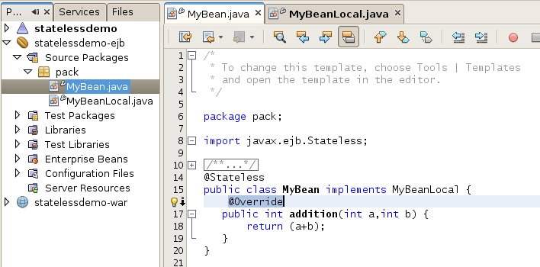

Slide 19
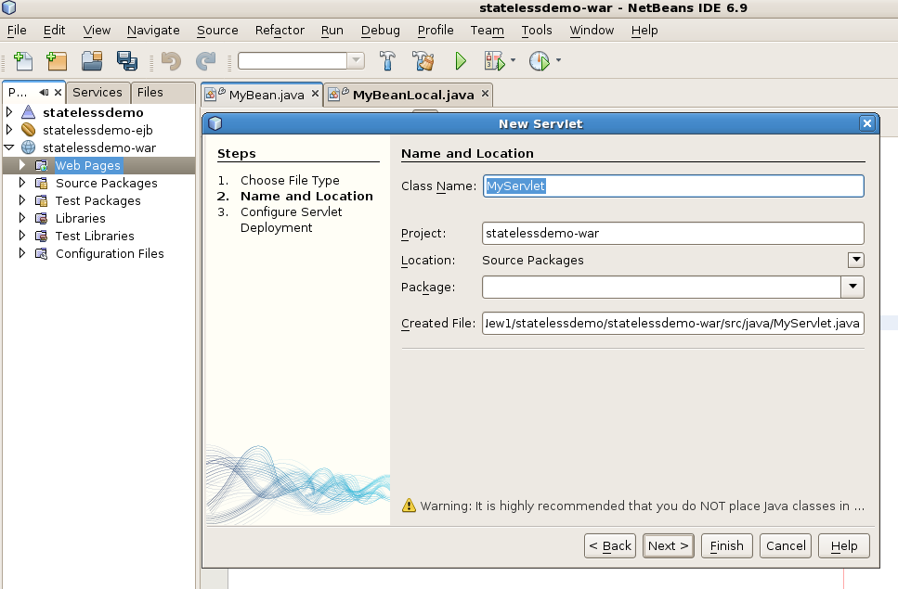

Slide 20
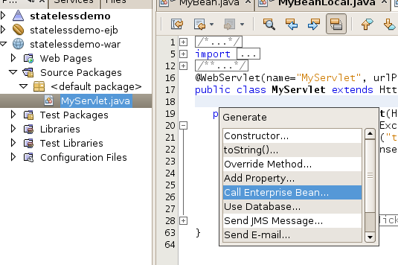
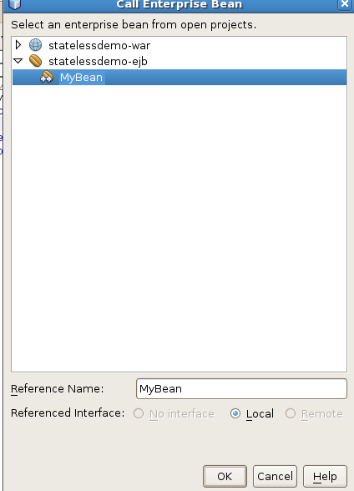
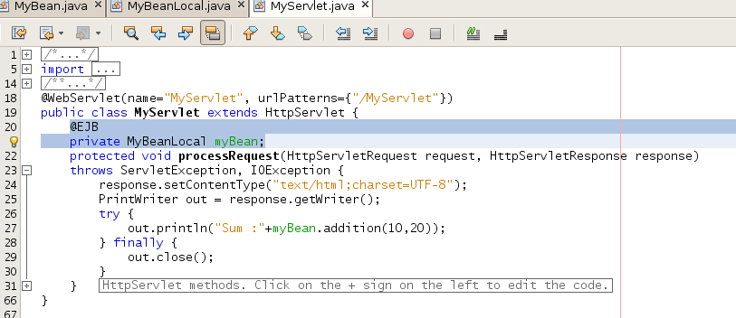

Slide 21
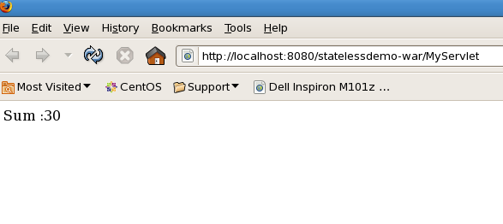
Output

